Slide 1


Types and Impacts of Conflict

Slide 2
Learning Objectives
01
To enable students to learn types of conflicts
02
To enable students to learn positive and negative impacts of conflict
Types and Impacts of Conflict

Slide 3

Types of Conflict?

Slide 4


Types of Conflict
Functional Conflicts:
Supports the goal of a group and also improves its performance. It is also known as positive conflict.
Dysfunctional Conflicts:
This kind of conflict obstructs the achievement of
the goals of a group. It is also known as destructive conflict.
Types and Impacts of Conflict
5

Slide 5
External Conflicts
Man vs. Man Conflict:
Man vs. Nature Conflict:
Man vs. Society Conflict:
Types and Impacts of Conflict
6

Slide 6
Intrapersonal Conflicts
Approach vs. Approach Conflict: In this type of conflict individual will have two desires
with positive emotions which are equally powerful. For example, a person has two attractive
job offers and he has to choose any one of them, as a result tension arises.
Approach vs. Avoidance Conflict: This conflict involves two goals with negative valence. At times the individual is forced to choose one among two negative goals. In such conflicts, both are unwanted goals, but he cannot keep quiet without choosing also.
Avoidance vs. Avoidance Conflict: In this type of conflict, a person is both attracted and
repelled by the same goal object. Here the goal object will have both positive and negative
attractiveness. The positive valence attracts the person, but as he approaches, the negative
valence repels him back. Attraction of the goal and inability to approach it leads to frustration
and tension
Types and Impacts of Conflict
7

Slide 7

Interpersonal conflict

Slide 8

Effects of conflicts

Slide 9

Positive effects of conflicts

Slide 10

Triggers the need for searching for new facts and solutions.
Improves group cohesiveness

Slide 11

Negative effects of conflicts

Slide 12

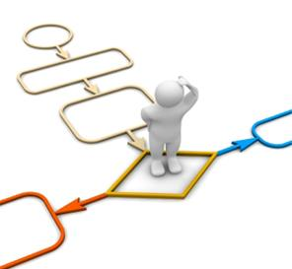
Reduces productivity
Delays the decision-making process

Slide 13
Thank you

